Slide 1

TEDDY FACED MICROSTRIP PATCH ANTENNA FOR LOWER 5G BANDS
DEPARTMENT OF ELECTRONICS AND COMMUNICATION ENGINEERING
Submitted by
N.V.L.VYSHNAVI ADDANKI 15KT1A0463
R.SAI KUMAR 15KT1A0483
SHAIK RESHMA 15KT1A0492
P.HEMANJALI 15KT1A0480
Under the Guidance of
Dr . J . LAKSHMI NARAYANA
Professor & Head of ECE Department
P.S.C.M.R COLLEGE OF ENGINEERING & TECHNOLOGY

Slide 2
CONTENTS:
Abstract
Aim and Objective
Motivation
Literature Survey
Methodology
Work Completed
Result
Conclusion
Scope
References

Slide 3
ABSTRACT
This paper presents a design of a cost-efficient micro strip patch antenna operating at 4.6 GHz for lower 5G bands. The proposed antenna consists of a teddy faced microstrip patch. The antenna is designed with dimensions of 18.3x13.24x1.6 mm on a FR4 substrate with a dielectric constant of 4.4.
The proposed antenna works at 3 different frequencies namely 7.96 GHz, 4.6GHz and 3.5 GHz with return loss -18.3dB, -20.3dB and -27.7dB.

Slide 4
AIM
To design an antenna which works on 5G for lower frequencies.
OBJECTIVE
To study antenna parameters
To study about the patch antenna
To design and simulate the antenna for lower 5Gfrequencies

Slide 5
MOTIVATION:
The usage of micro strip antenna became so wide because of its small size and less weight.
The purpose of designing an antenna at 5g band is that it has low radiation and can be used for smart tracking

Slide 6
Literature Survey
The lower 5G bands are used in United States, Japan, India and Europe[1].
Return loss is the measure of how small the ‘return’ or reflection of power[2].
Using S-Parameters return loss can be calculated from the Scattering matrix[3].
A VSWR value under to is considered suitable for most antenna applications[4].
The lower frequencies are the best compromise between capacity and coverage[5].
There are different applications at various frequencies[6].

Slide 7
METHODOLOGY :
A microstrip patch antenna with microstrip line feeding technique is used and results are obtained.
The microstrip patch antenna is simulated on FR4 substrate material.
Antenna 1 is designed to work at 5G bands operating at a single frequency
Antenna 2 is designed by inserting slots on the patch of the antenna operating at two different bands
Antenna 3 is designed with a teddy shaped slot in a c shaped slot on the patch ,the ground consists of a rectangular slot embedded with a teddy face operating a three different frequencies.

Slide 8
WORK COMPLETED AND PROGRESSED TILL DATE
 | Work Done | Work to be Done
November-2018 | Study of Base paper
December - 2018 | Antenna parameters
January - 2019 | Design of basic patch antenna.
February -2019 | basic patch antenna is modified for better bandwidth.
March -2019 | Antenna is designed for multiple bands | Documentation and base paper

Slide 9
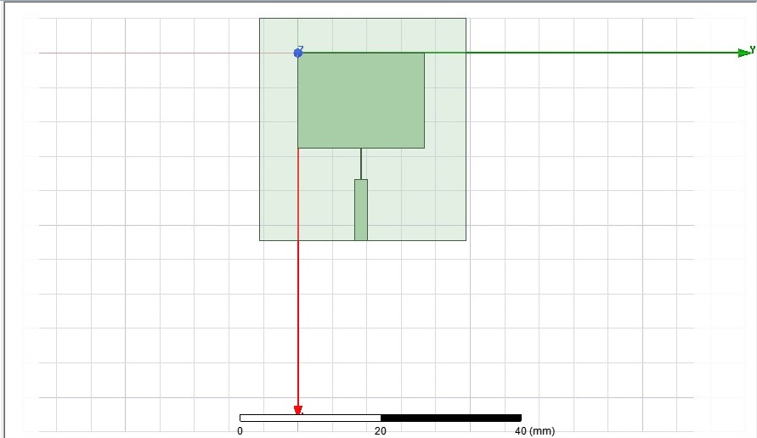
Antenna 1
Rectangular patch antenna is designed using fr4 substrate and it is fed with microstrip line feeding technique.

Slide 10
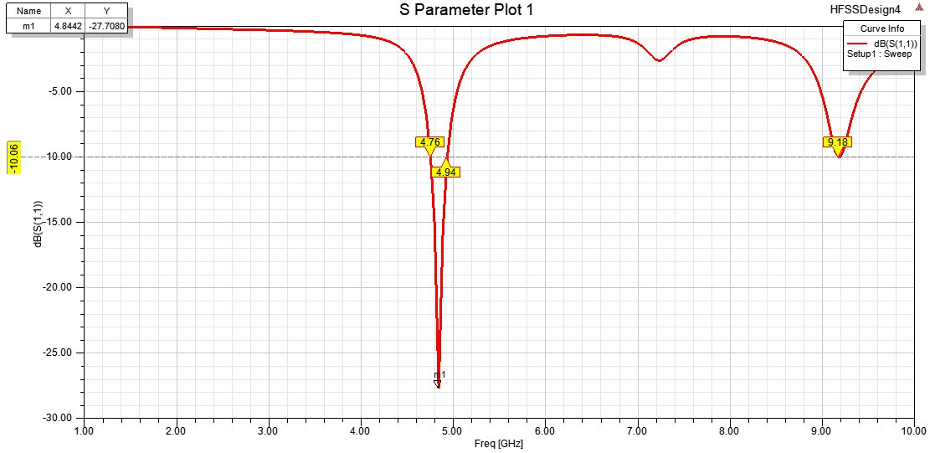
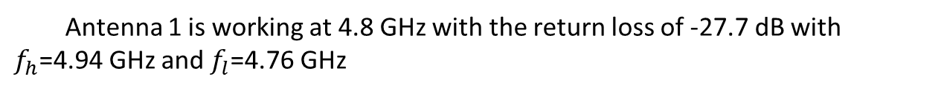
S-parameter for Antenna 1(Return loss)
Antenna 1 is working at 4.8 GHz with the return loss of -27.7 dB with $f_{h}$=4.94 GHz and $f_{l}$=4.76 GHz

Slide 11
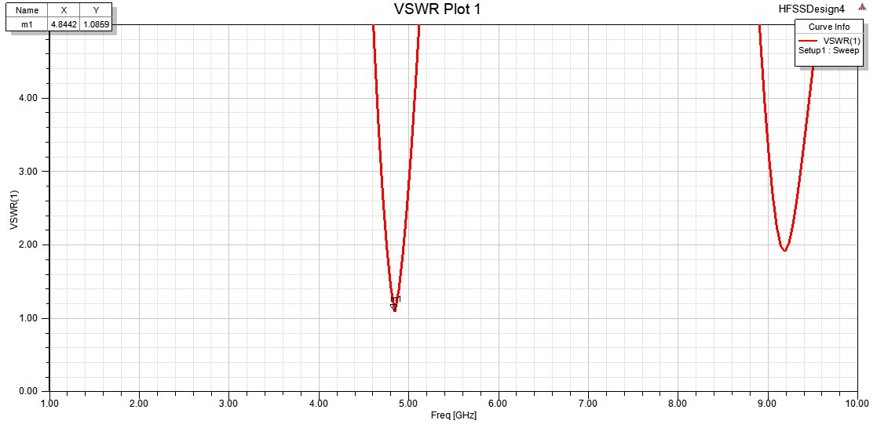
VSWR Plot For Antenna 1
VSWR(Voltage Standing Wave Ratio) : The amount of mismatch between an antenna and the feed line connecting to it.
VSWR= (1+|Г|)/(1-|Г|)

Slide 12
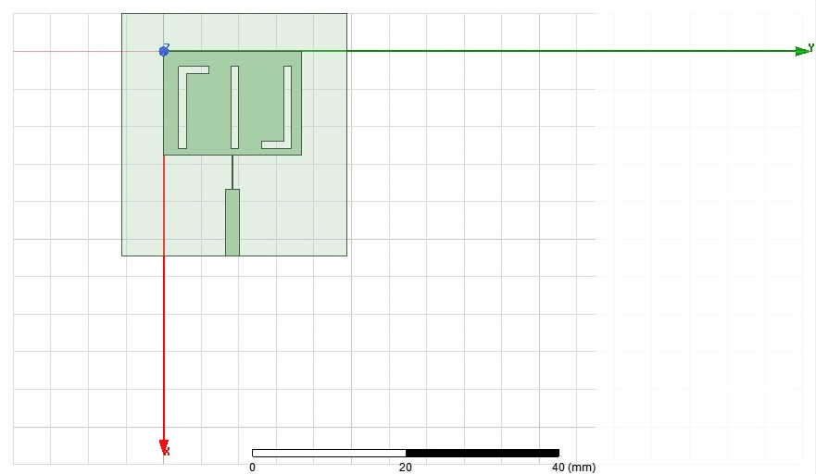
Antenna 2
The antenna 2 is designed by implementing some slots on the rectangular patch of the antenna.

Slide 13
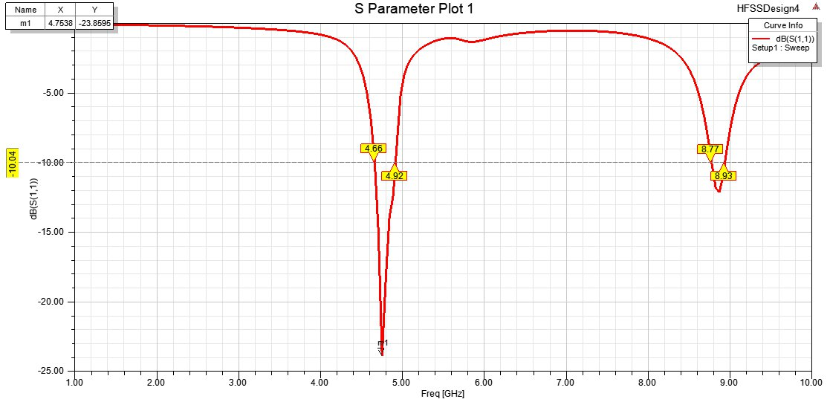
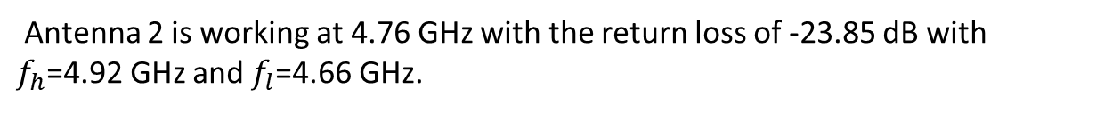
S-parameter for antenna 2
Antenna 2 is working at 4.76 GHz with the return loss of -23.85 dB with $f_{h}$=4.92 GHz and $f_{l}$=4.66 GHz.

Slide 14
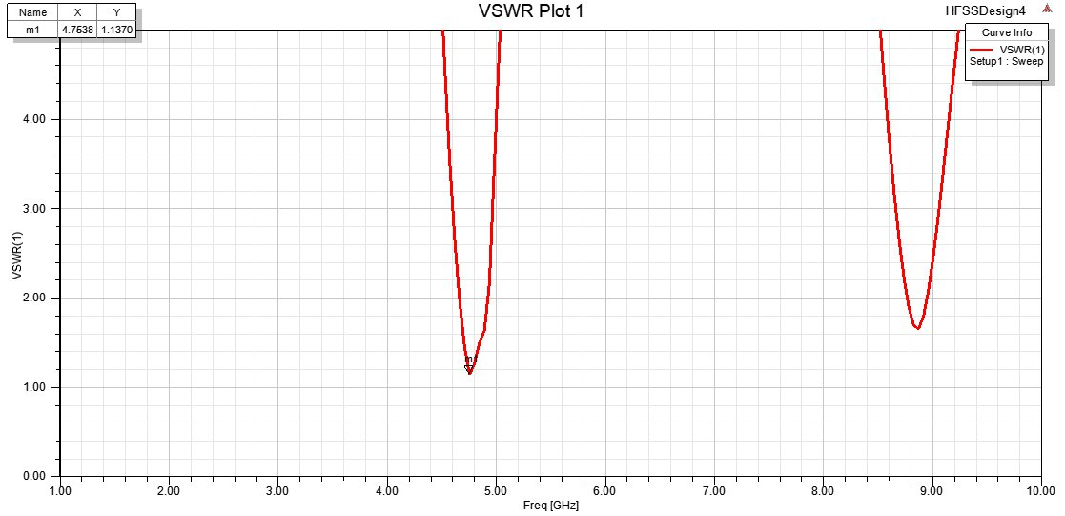
VSWR plot for Antenna 2
vswr

Slide 15
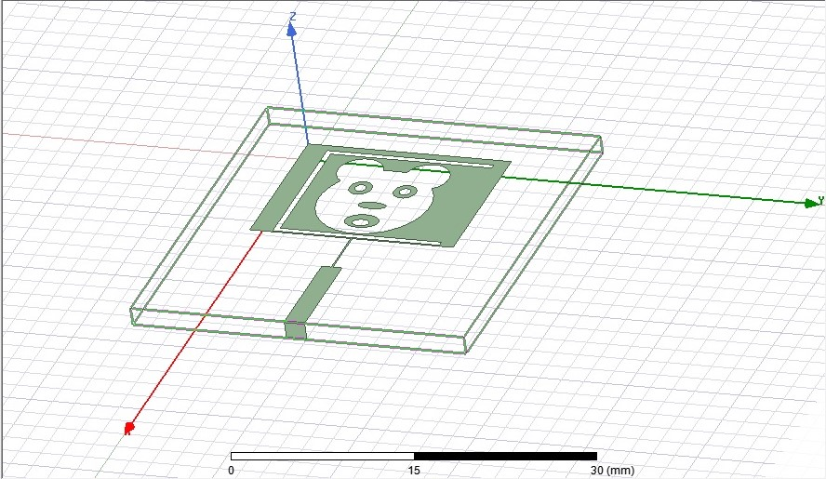
Top view of Proposed Antenna
A teddy faced slot is surrounded by c shaped slot, which is implemented on the rectangular patch.

Slide 16
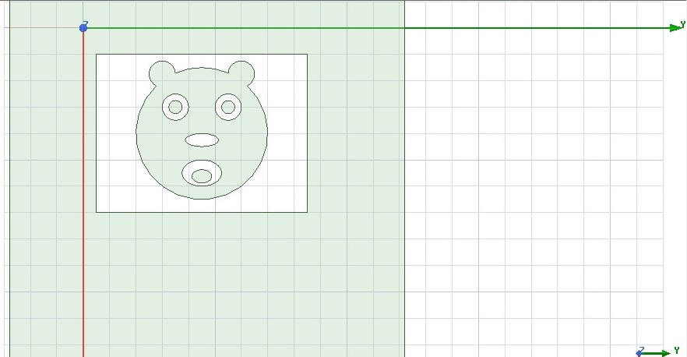
Back view of Proposed Antenna
A teddy face is embedded on the rectangular slot on the ground.

Slide 17
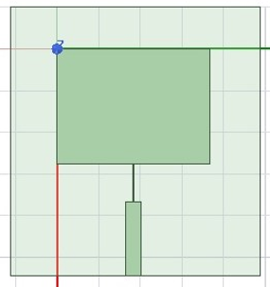
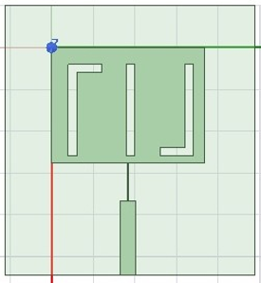
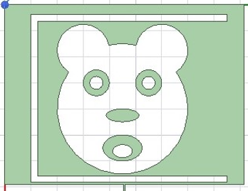
Antenna designs
Antenna(i) Antenna(ii) Antenna(iii)

Slide 18
Applications of the designed antennas
Design | Resonant Frequency | Operating Frequency | Applications
Antenna (i) | 5 GHz | 4.7 GHz | Log distance radio applications
Design | Resonant Frequency | Operating frequency | Applications
Antenna(ii) | 5 GHz | 4.7 GHz | Long distance radio communications
 |  | 8.8 GHz | Satellite, radar and space communications
Design | Resonant Frequency | Operating Frequency | Applications
Antenna(iii) | 5 GHz | 7.96 GHz | radar, satellite communications
 |  | 4.6 GHz | mobile phones and commercial wireless LAN.
 |  | 3.5 GHz | fixed satellite service and radiolocation service.

Slide 19
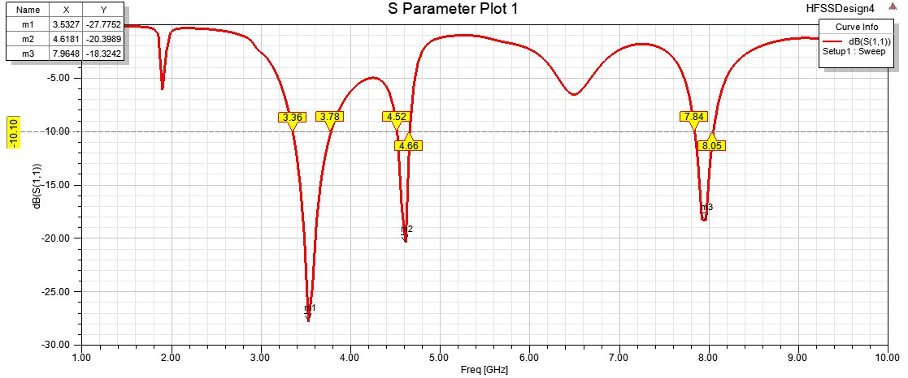
Results s-parameter
Antenna 3 is working at two 5G frequencies namely 3.5 GHz and 4.6 GHz and one X-band frequency i.e., 7.96 GHz.

Slide 20
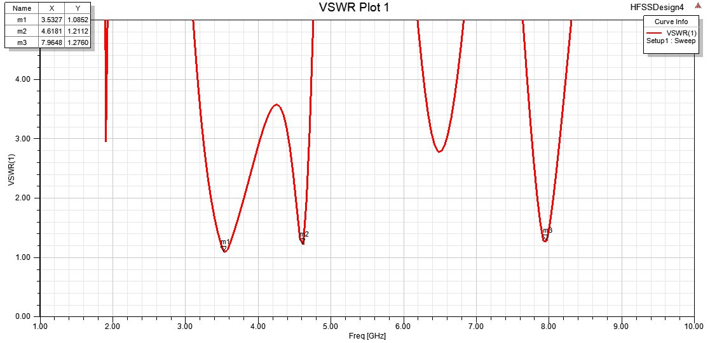
VSWR plot

Slide 21
CONCLUSION
The antenna consists of a c shaped slot on the rectangular patch with a teddy faced slot on the patch and the ground as well.
With the same size it works for multiple frequencies namely 7.96 GHz, 4.6 GHz and 3.5 GHz with return loss -18.3dB, -20.3dB and -27.7dB.

Slide 22
SCOPE
The design can be further modified by reducing the size and bandwidth can be enhanced for these particular band of frequencies.

Slide 23
REFERENCES
[1] https://www.rfpage.com/what-are-5g-frequency-bands/
[2] https://antennatestlab.com/antenna-education-tutorials/return-loss-vswr-explained
[3]https://www.researchgate.net/post/how_S_Parameters_are_helpfull_in_analysis_of_Antenna/amp
[4] https://www.mobilemark.com/faqs/what-is-meant-by-the-vswr-of-an-antenna/
[5] https://www.everythingrf.com/community/5g-frequency-bands
[6]public_policy_position_5g_spectrum.

Slide 24
THANK YOU

